Slide 1
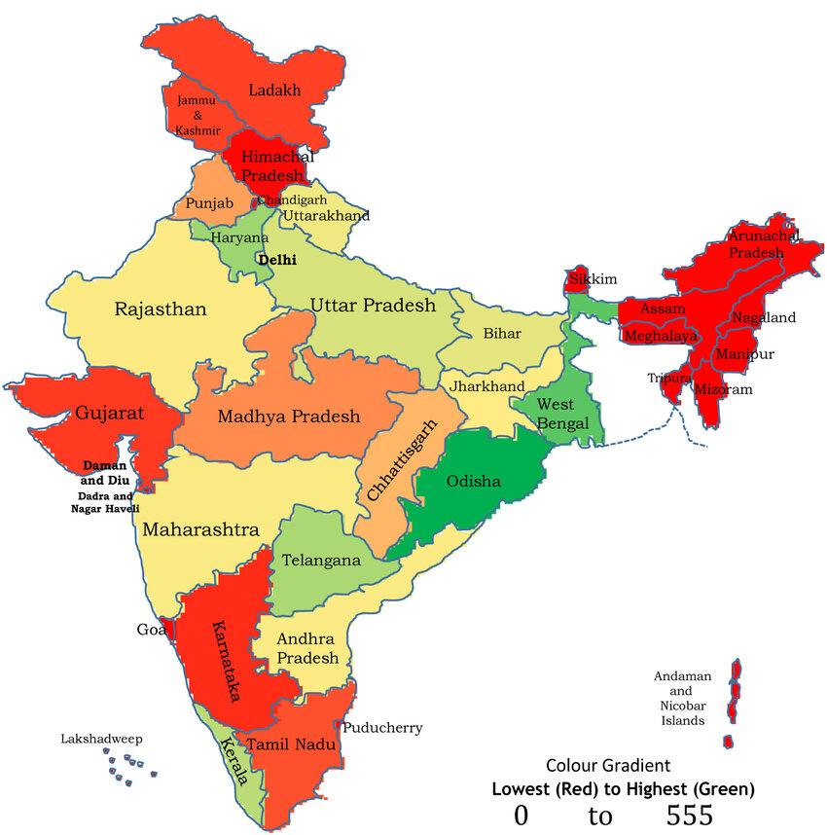


BA
P172
Project Name:
P172- Bank Analytics
Himanshu Mathur
Project Outline:
Bank Analytics on Customer Loans;
Analysis done on;
Microsoft Excel:
MYSQL:
Tableau:
PowerBI:
Vishal Purohit
Punam N Kurkure
Mohd Arif
Project Co-ordinator: Mr. Arun
Project Evaluator:
Ms. Deepti
Basudeo Mundhra
Akhila

Slide 2
KPI 1- Year wise loan amount Stats
Loan Amount Trend:
Consistently increasing over the years, indicating a growth in borrowing or lending activities.
Accelerated and Exponential Growth:
A substantial increase from 2008 to 2009, with an even larger rise from 2009 to 2010 indicates a period of rapid growth in borrowing or lending, possibly influenced by economic factors or market conditions. 2011 doubled borrowings is showing exponential growth.
Highest Loan Amount:
The highest loan amount recorded was $260,506,575 in 2011, indicating increased demand for loans or the availability of larger loan amounts compared to the previous years.

Slide 3
KPI 2- Grade and Sub Grade wise Revol_Bal
Grade | Revol_bal | Remarks | Risk Assessment
A | 114,774,099 | higher sums of revolving balances | potentially lower credit risk and better credit utilization
B | 161,308,549 | significant amount of outstanding debt | higher credit risk compared to lower-grade categories
C | 110,120,710 | substantial level of outstanding debt | moderate Credit Risk
D | 74,490,429 | lower total revolving balances compared to grades A, B, and C | comparatively lower credit risk
E | 46,074,539
F | 18,282,816
G | 6,462,726
An indicator to evaluate a borrower's creditworthiness and determine their ability to manage and repay debt.
Credit Utilization:
Higher sums in Grades and Subgrades suggest higher levels of outstanding debt in relation to the available credit limits. Grades with higher sums may indicate a higher level of credit risk or a larger number of borrowers with higher credit utilization.
Subgrade Variations:
within the same grade, there are variations in creditworthiness and credit utilization among borrowers.
Total revolving balances provide some insight into credit risk, a comprehensive risk assessment would consider additional factors such as default rates, delinquency rates, borrower profiles, and other relevant financial information. The total revolving balances are just one aspect of the overall risk evaluation for each grade.

Slide 4
KPI 2- Grade and Sub Grade wise Revol_Bal

Slide 5
KPI 3- Total Payment for Verified Status Vs Total Payment for Non-Verified Status
Verification Status | Total Payment | Average of dti
Not Verified | 153,541,418 | 13.02
Source Verified | 109,270,668 | 12.61
Verified | 219,892,308 | 14.25
Grand Total | 482,704,394 | 13.32
Verification status typically relates to the verification of borrower information and documentation, which can impact the lender's confidence in the borrower's ability to repay the loan.
DTI is a financial metric used to measure an individual's or household's debt burden relative to their income.
A lower DTI ratio generally strengthens a borrower's loan application and increases their chances of loan approval.
Default rates, delinquency rates, borrower profiles, and other relevant financial information are equally critical to verify along with verified and non verified source.

Slide 6
KPI 4- State wise and Last Credit Pull date Wise Loan Status
Credit Worthiness:
Valuable information for assessing the creditworthiness of borrowers and managing loan portfolios.
Risk Assessment:
Lenders can assess the credit risk associated with borrowers in different states.
Geographic Insights:
State-wise loan data provides insights into regional economic conditions, credit environments, and borrower characteristics.
Portfolio Management:
The information helps banks and financial institutions in managing their loan portfolios effectively. They can evaluate the performance of loans in different states and make informed decisions

Slide 7
KPI 5- Home ownership Vs last payment Date Stats
Timeliness of Payments:
Comparing the last payment date with home ownership status can reveal the numbers of homeowners who make their mortgage payments on time versus those who have delayed or missed payments. This data can indicate the overall financial health and responsibility of homeowners.
Default Rates:
Examining the correlation between home ownership and the last payment date can help identify the percentage of homeowners who have defaulted on their mortgage and other payments.
Loan Performance:
Analyzing the last payment date in relation to home ownership can provide insights into the performance of mortgage loans. Lower delinquency rates and timely payment patterns are generally desirable for loan performance.
Foreclosure Trends:
By tracking the last payment date and home ownership status, lenders can monitor foreclosure trends.

Slide 8
KPI 5- Home ownership Vs last payment Date Stats

Slide 9
KPI 5- Home ownership Vs last payment Date Stats

